Slide 1


Smt. Kashibai Navale College Of Engineering Department of Information Technology
Document Verification and Validation using Blockchain
Group No : 5
Dipali Sanjay Chavan - I4139
Radhika Natwarlal Dayama - I4144
Pratik Prashant Joshi - I4171
Prajyot Pradip Pawar – I4236
Under Guidance of
Prof. A.D.Londhe
A. Y. 2022-2023

Slide 2
Contents
Problem Statement of Project.
Introduction
Literature Survey
System Architecture
Requirement Analysis
Methodology
Algorithms
Project Design
Project Planning
Conclusion
References
Document Verification and Validation using Block chain

Slide 3
Problem Statement of Project
In this research to design and develop a system for dynamic and secure document verification and QR code generation system using smart contract in blockchain environment. In this work we also illustrates own blockchain in open source environment with custom mining strategy as well as smart contract. Finally validate and explore system performance using consensus algorithm for proof of validation.
Project Group No: 5

Slide 4
Introduction
Educational documents verification is very tedious and time consuming process in real time environment.
QR code generation for entire educational history is easy process to eliminate such consuming tasks.
Dynamic QR-code and unique certificate generation for each students document in proposed system.
Data QR code stored into the blockchain in secure manner which enhance the security.
According to the smart contract system also allow the updates in entire blockchain.
This research proposed a custom blockchain generation on open source platform.
Project Group No: 5

Slide 5
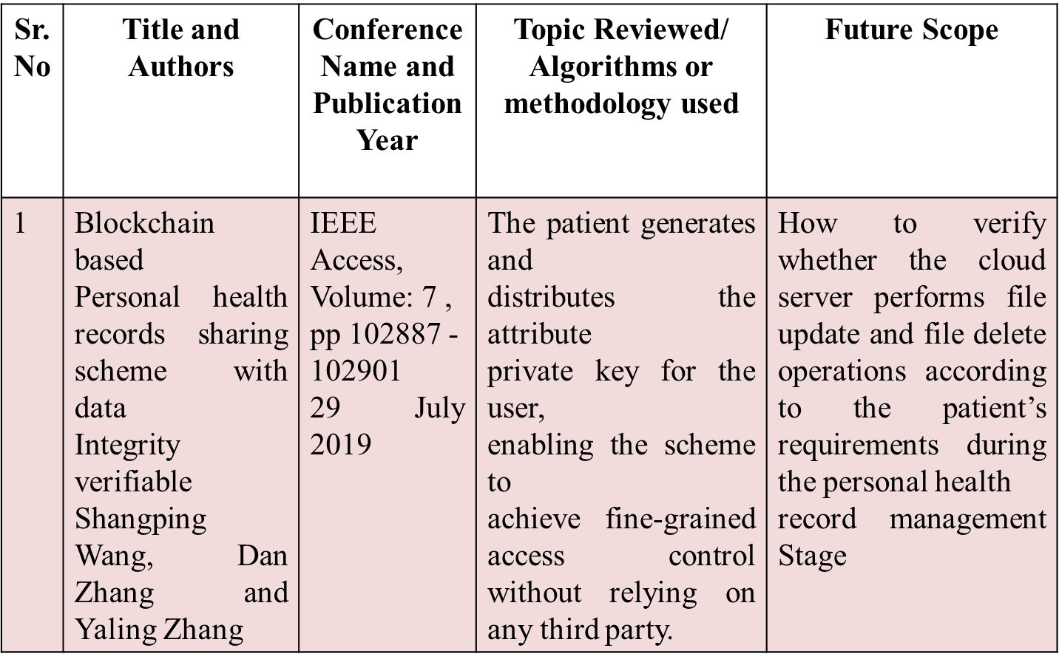
Literature Survey
Project Group No: 5

Slide 6
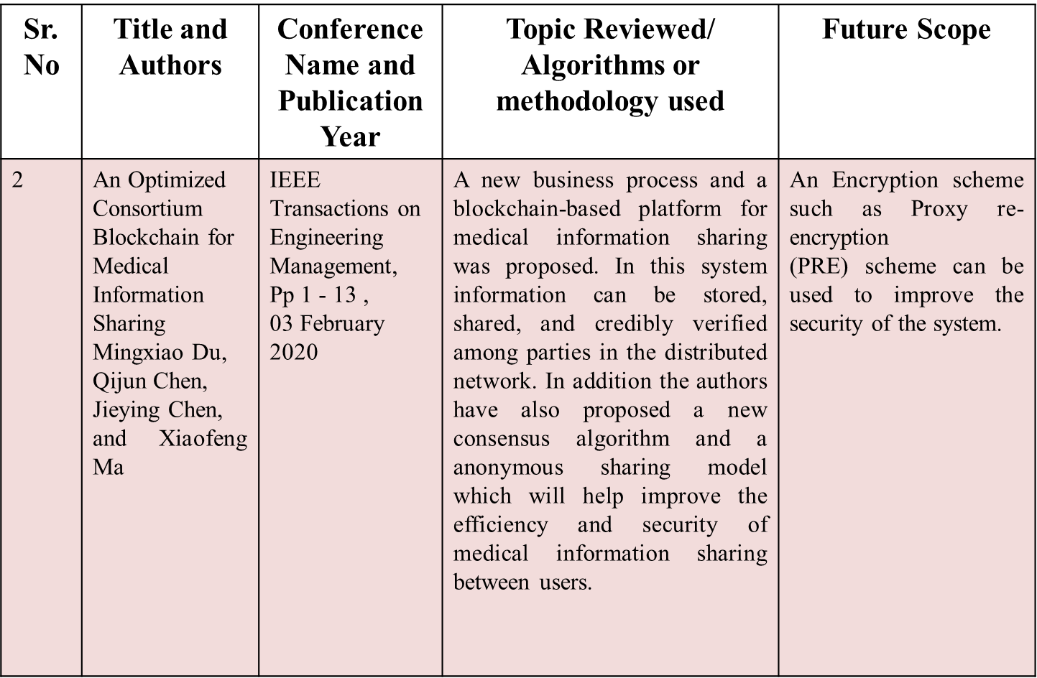
Literature Survey
Project Group No: 5

Slide 7
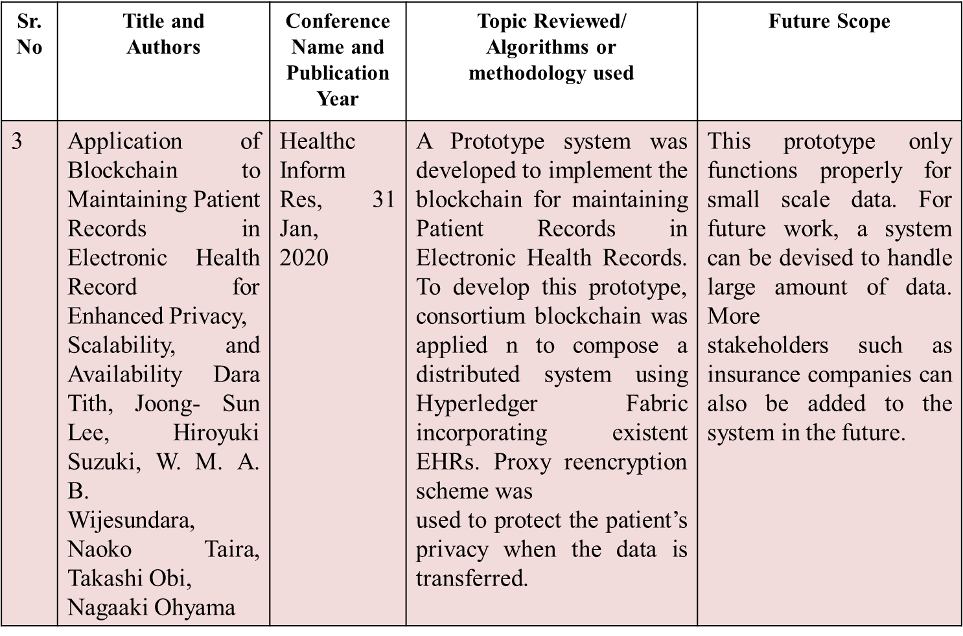
Literature Survey
Project Group No: 5

Slide 8
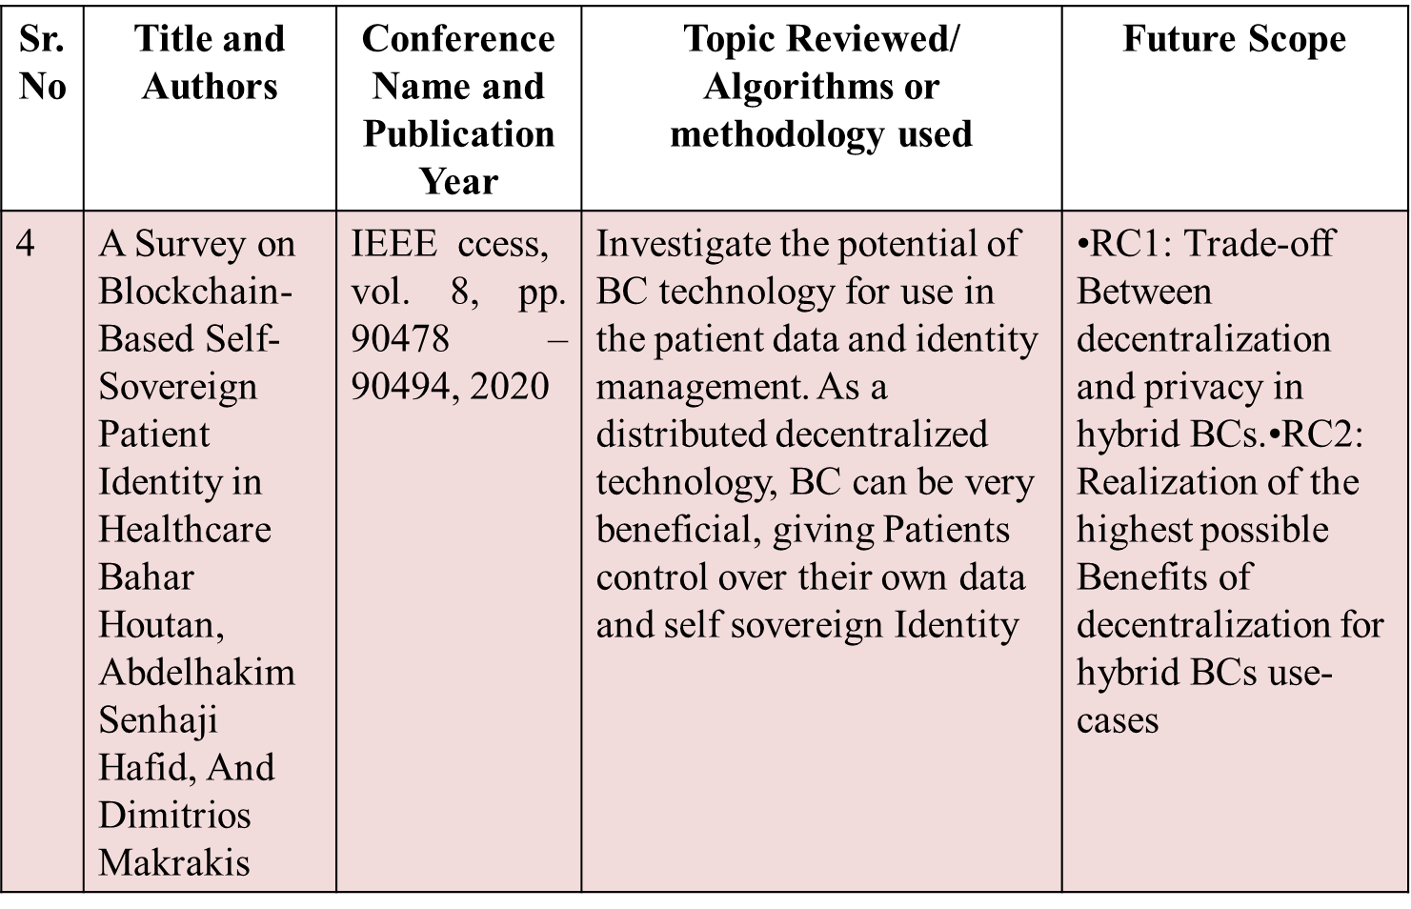
Literature Survey
Project Group No: 5

Slide 9
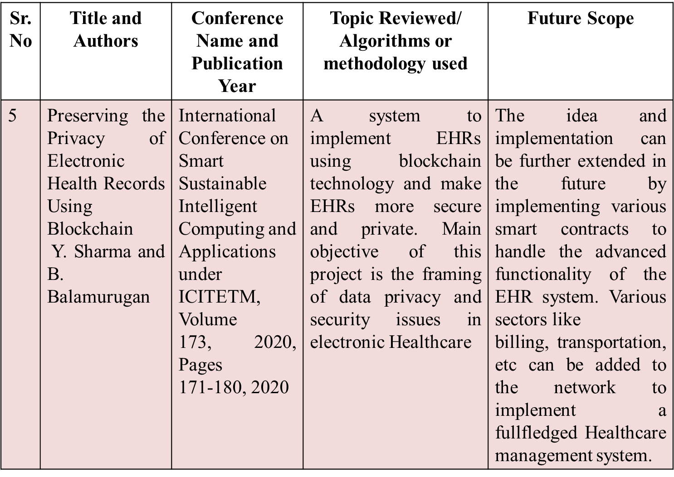
Literature Survey
Project Group No: 5

Slide 10
Requirements Analysis
Software Interfaces:
Operating system: OS.
Coding Language : Java
Database :MYSQL
IDE : Eclipse IDE, Netbeans IDE
Front End JSP and Servlet
Back End Servlet/Data Base(MYSQL)
Hardware
Processor:- Intel Pentium 4 or above
Memory:- 2 GB or above
Other peripheral:- Printer
Hard Disk:- 500gb
Project Group No: 5

Slide 11
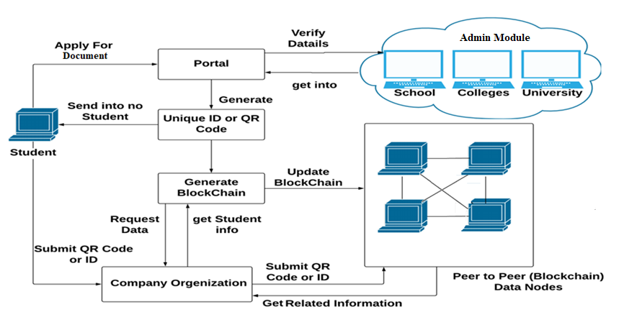
Framework of the proposed work
Project Group No: 5

Slide 12
Methodology
System Module
Admin(School, College and University)
Student
Company
System proposed a new dynamic document generation approach using own custom blockchain.
First student apply for document on web portal with upload all educational documents.
Web portal is authenticate trusted third party which validate all documents from university, school, colleges etc.
Project Group No: 5

Slide 13
Methodology
Once successfully verification has done from university, school, colleges it will store data into blockchain and same time it generates the unique certificate id or QR code and returns to student.
Student can submit the received QR code or certificate id to organization instead of physical hard copy of documents.
Organization can submit QR code or id to portal and pool the document of respective student and make the validation.
The entire process has perform into the block chain manner with smart contract which is written by us.
Project Group No: 5

Slide 14
Algorithms
Algorithm 1: Protocol for Peer Verification
Algorithm 2: Mining Algorithm for valid hash creation
Algorithm 3: Validated Block chain and majority algorithm
Algorithm 4: Recover Block Chain Data
Project Group No: 5

Slide 15
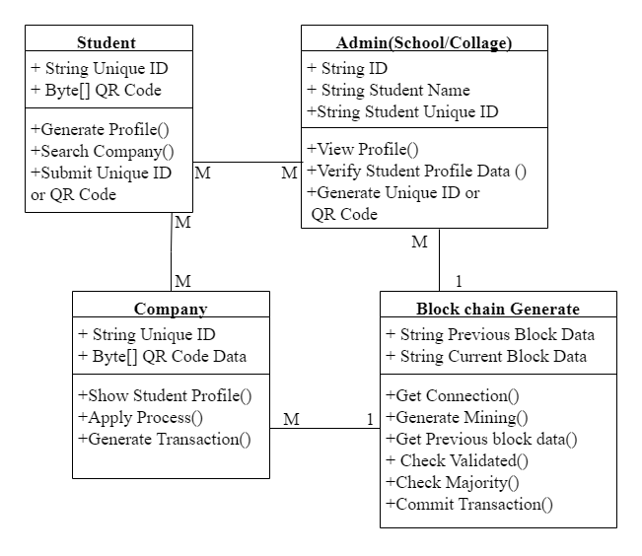
Project Design
Class Diagram
Project Group No: 5

Slide 16
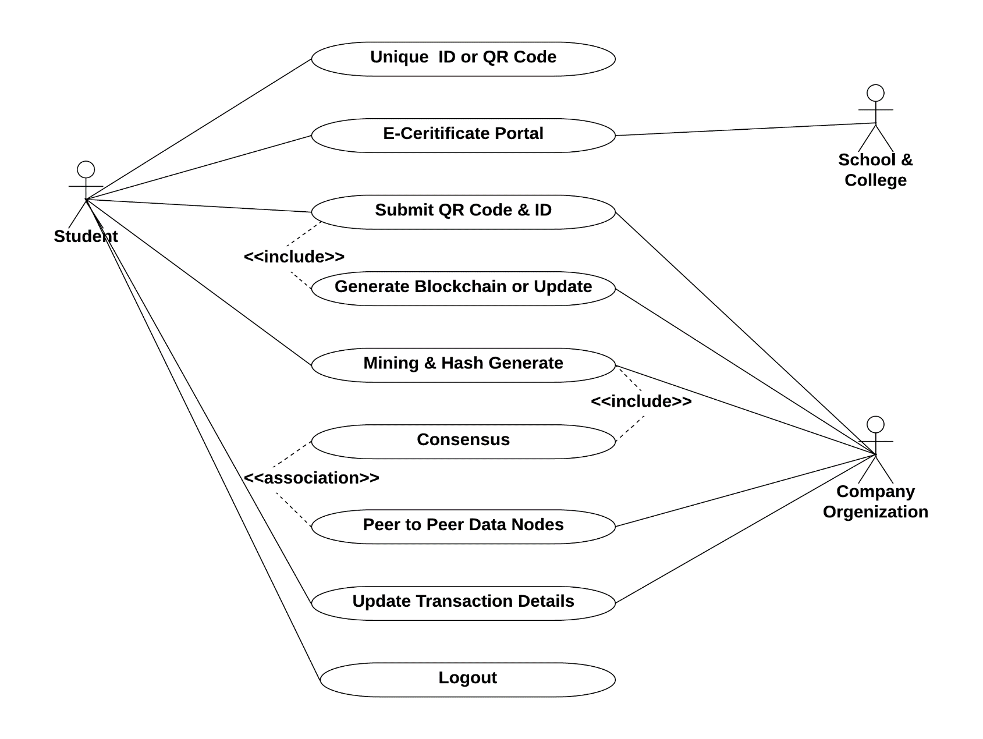
Project Design
Use Case Diagram
Project Group No: 5

Slide 17
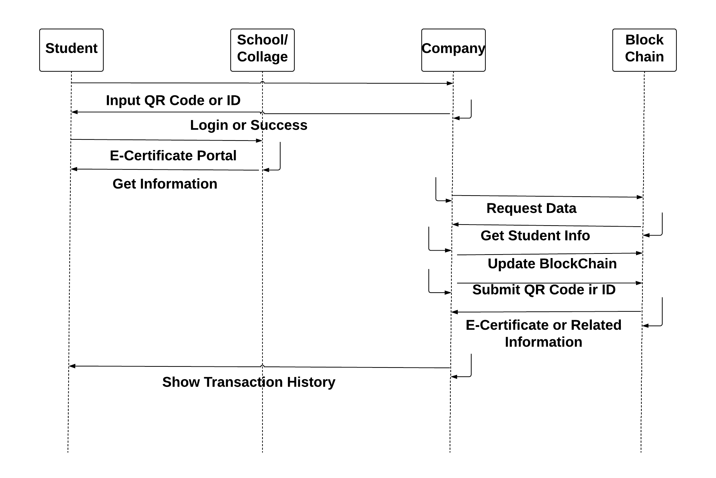
Project Design
Sequence Diagram
Project Group No: 5

Slide 18
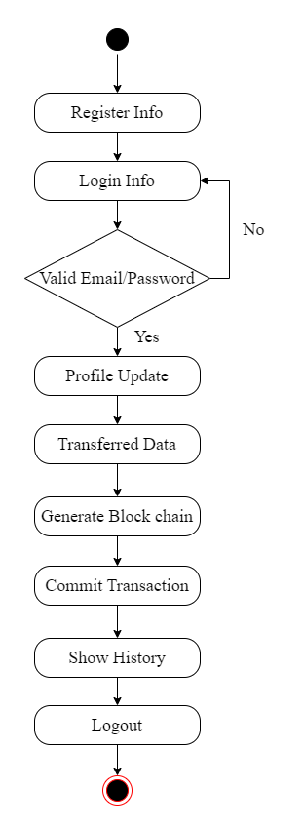
Project Design
Activity Diagram
Project Group No: 5

Slide 19
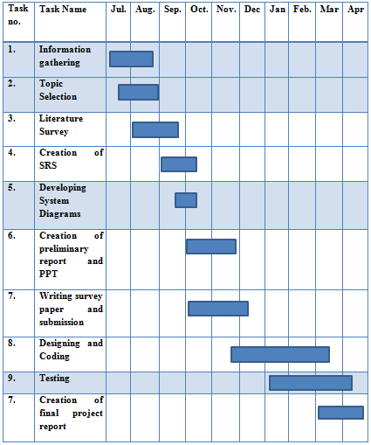
Project Planning
Project Group No: 5

Slide 20
Conclusions
It is an smart system for generate a dynamic certificate using blockchain and given smart contract.
The proposed mining approach generate the strong hash with minimum difficulties.
According to mentioned smart contract system can allow to update for entire bloc
It can also detect and prevent various network as well as database attacks.
Project Group No: 5

Slide 21
References
[1] Sharma, Yogesh, and B. Balamurugan. "Preserving the privacy of electronic health records using blockchain." Procedia Computer Science 173 (2020): 171-180.
[2]Sun, Jin, et al. "Blockchain-based secure storage and access scheme for electronic medical records in IPFS." IEEE Access 8 (2020): 59389-59401.
[3]Harshini, V. M., et al. "Health record management through blockchain technology." 2019 3rd International Conference on Trends in Electronics and Informatics (ICOEI). IEEE, 2019.
[4] Liu, Xiaoguang, et al. "A blockchain-based medical data sharing and protection scheme." IEEE Access 7 (2019): 118943-118953.
[5] Gutiérrez, Omar, et al. "HealthyBlock: Blockchain-Based IT Architecture for Electronic Medical Records Resilient to Connectivity Failures." International Journal of Environmental Research and Public Health 17.19 (2020): 7132.
[6] Wang, Shangping, Dan Zhang, and Yaling Zhang. "Blockchain-based personal health records sharing scheme with data integrity verifiable." IEEE Access 7 (2019): 102887-102901.
Project Group No: 5

